Slide 1
Lending Club
Using Analytics to Understand P2P Lending from an Investor’s Perspective
By Matthew Coleman

Slide 2
Introduction
Started in 2007, Lending Club is an online peer-to-peer lending platform that offers unsecured personal loans
P2P lending services are a convenient and increasingly popular way to take out personal loans
Very quick application process (under 30 minutes) and funding takes less than 3 days
Any user that meets minimum requirements for income & net worth can back loans via Lending Club’s investment platform

Slide 3
About the Data
Lending Club’s personal loan data is available from 2011-present on the following site: https://www.lendingclub.com/info/download-data.action
Data from calendar years 2014 & 2015 were selected for this analysis
Loans from these years have enough history to determine successful repayment
Data from prior years may be less accurate or be affected by differences in macroeconomic environment
After cleaning, a 10% sample was taken of original dataset to facilitate analysis

Slide 4
Objective
Identify specific characteristics of loans that cause the probability of defaulting to be higher or lower.
Create and refine a model that can be used to separate successful loans from potential defaults.
Develop an investment strategy that will yield the highest overall ROI.

Slide 5
Data Wrangling
Original dataset consisted of 650,000 rows each corresponding to a loan and 137 columns providing details on the loans
Removed any columns missing values in >85% of rows
Remaining columns that were missing values addressed in one of two ways:
Creating new variable indicating whether or not a value was present in the original variable (e.g. “Ever Delinquent” in place of “Number of delinquencies”)
Imputing values, typically with medians but often with zero’s depending on the case
Re-formatted employment length and issue date columns
Created “defaulted” column as a True/False

Slide 6
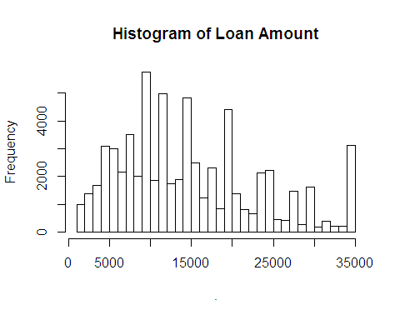
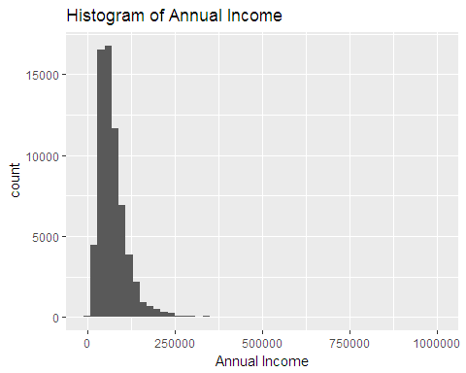
Visualizing Loan Amount & Annual Income
Loan amount & annual income are both right-tailed distributions. Loans are typically taken out in multiples of $5k, with large number of loans taken out for the max of $35k.

Slide 7
Analyzing Loan Terms
Borrowers on a 60-month loan term defaulted at a rate of 15.9% vs. 10.8% for 36-month loans.
2-sample test of equal proportions: null hypothesis of equal proportions rejected at 95% confidence.
Borrowers on 60-month term have a median annual income of $70,000, 14.8% higher than borrowers of 36-month loans.
Median loan amount for 60-month loans was $19,200 or 92% higher than 36-month loans.
60-month loans have a median monthly installment of $455.72 compared to $343.39 for 36-months.

Slide 8
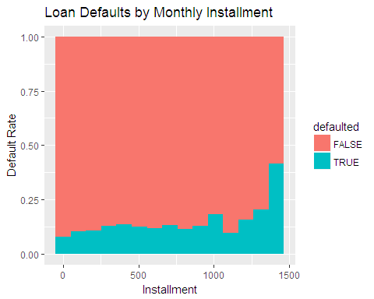
Monthly Installments
Higher monthly installment bins show higher default rates
If monthly expenses exceed income, borrower may not be able to pay off loans.
Higher installments on the 60-month loans may be the root cause for the higher default rate.

Slide 9
Debt-to-Income Ratio
Borrowers of 60-month loans have 19.2% debt-to-income prior to the loan being issued
Borrowers of 36-month loans have 17.6% debt-to-income.
Since this metric is measured prior to the loan being issued, it does not provide an accurate picture of borrower’s current financial situation.

Slide 10
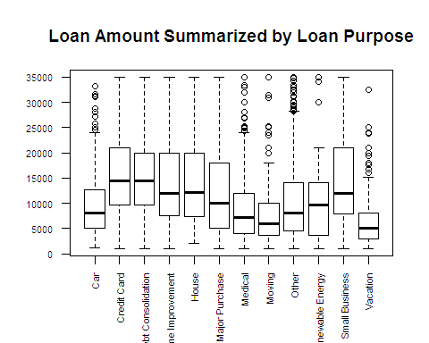
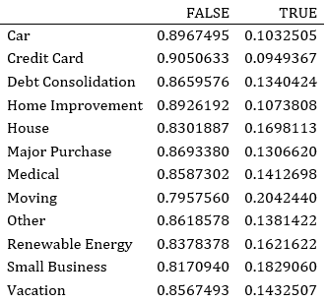
Loan Purpose
Small business loans tend to be issued for the largest amount, followed by credit card loans and debt consolidation.
Default rates are highest for moving loans at 20.4%, despite moving loans having the second-lowest median loan amount.
Small business loans default 18.3% of the time and house loans have a 17% default rate.
Default rate for credit card loans is lowest at 9.5%
Most common homeownership type for moving loans is renters at 79%
Renters default 14.6% of the time vs. total sample proportion of 12.4%.

Slide 11
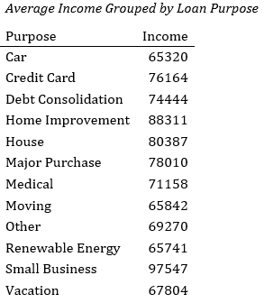
Loan Purpose (cont’d)
Borrowers who listed “moving” as the loan purpose have the second-lowest mean annual income across all loan purpose groups
Most borrowers in “moving” category are also renters, who earn less on average than homeowners
Taking out a loan for moving expenses may be indicative little or no savings

Slide 12
Employment Length
Employment length often viewed as a measure of financial stability.
Frequently beginning new jobs can be disruptive to income.
Longer employment corresponds to higher, more consistent income and easier budgeting.
Borrowers with less than 1 year of employment have a mean income of $70,935, which gradually increases with employment length.
The default rate for less than 1 year of employment is 14%.
Borrowers with 10+ years of employment have a mean income of $82,328 and default rate of 10.9%.
Mean income for borrowers who did not list employment is $49,464. Default rate for this group is 16.5%.

Slide 13
Logistic Regression
The goal of logistic regression is to accurately predict whether loans will default or be successfully repaid.
Using the model, we can classify loans as high-risk or low-risk and determine the average return on investment for these two loan groups.
In R, a glm was created using defaults as the response variable and selecting the following features
Loan Amount
Term
Employment Length
Homeownership Type
Annual Income
Loan Purpose
Debt-to-Income

Slide 14
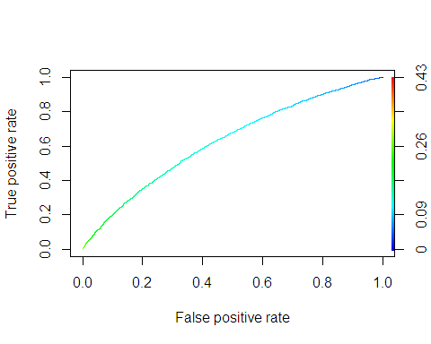
Initial Model - Results
Loan amounts & debt to income positively correlated with defaults.
60-month loan terms & renters associated with increased defaults.
Lower incomes lead to higher default rates.
Employment length over 10 years significantly reduces defaults.
Small business loans are a significant predictor of defaults.
True positive rate of 54.2%, false positive of 64.1%.
Out-of-sample accuracy of 62.9%.

Slide 15
Improving the Model
Created a new feature, loan-to-income ratio, equal to loan amount divided by annual income.
This feature replaced both annual income and loan amount.
Added bankcard utilization percentage and “ever delinquent”, a true/false indicating any delinquencies in the borrower’s credit history.
Loan-to-income has a coefficient of 1.48 and an extremely low p-value.
Coefficient for bankcard utilization is close to zero.
The variable for delinquencies is also a significant predictor with a coefficient of 0.13.
True positive rate of 52.7%, out-of-sample accuracy improved 1bp to 63.9%.

Slide 16
Estimating Return on Investment
Using the model, loans were separated into two datasets: high-risk (above risk threshold) and low-risk (below the threshold)
For loans that defaulted, estimated total payout as the total payments made to date.
For loans that did not default, total payout was estimated as monthly installment multiplied by term in number of months
On average, low-risk loans out-performed high-risk loans in both 36-month and 60-month loan categories.

Slide 17
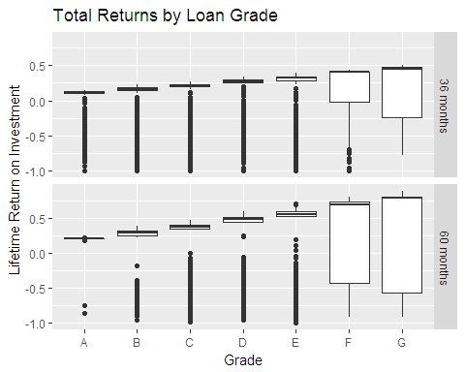
Using Lending Club’s Grading System
Both the risk and total potential returns increase as loan grade gets worse.
Average returns decrease due to frequent defaults among high-risk loans.
Risk-averse investors can virtually guarantee a small profit by investing in diversified portfolio of high-grade loans.

Slide 18
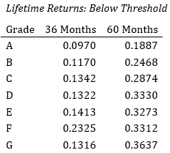
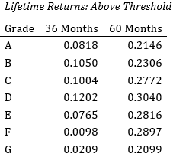
Combining the Model with Lending Club Grades
Divided loans into high-risk and low-risk groups and then summarized ROI by grade.
Loans that received poor grades from Lending Club but fell below risk threshold in the model have the highest returns.

Slide 19
Conclusion
Basic considerations for any investment opportunity are risk and potential rewards.
Lending Club’s platform empowers investors to select loans to back based on their investment preferences and spread funds across groups of loans.
Characteristics associated with higher risk include 60-month term, renters, loan-to-income ratio, employment history and delinquencies in credit history.
Using the logistic regression model, loans can be separated into low and high risk groups.
Loans in low-risk group that received a poor grade from Lending Club may be “underrated”.
Historically, a well-diversified portfolio of low-risk/poor grade loans would yield the greatest return on investment.

